Slide 1
Computing and Global Health Lecture 8 Health Worker Support
Winter 2015
Richard Anderson

Slide 2
Today’s topics
Health workers
Worker tracking and supervision
Worker support tools
Commcare
ARTH Case study
Security and Privacy discussion

Slide 3
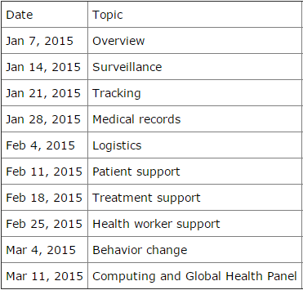
Readings and Assignments
Readings
Commcare papers
Homework 7
Paper prototype of IMCI Diarrhoea
Homework 8
Open Data Kit

Slide 4
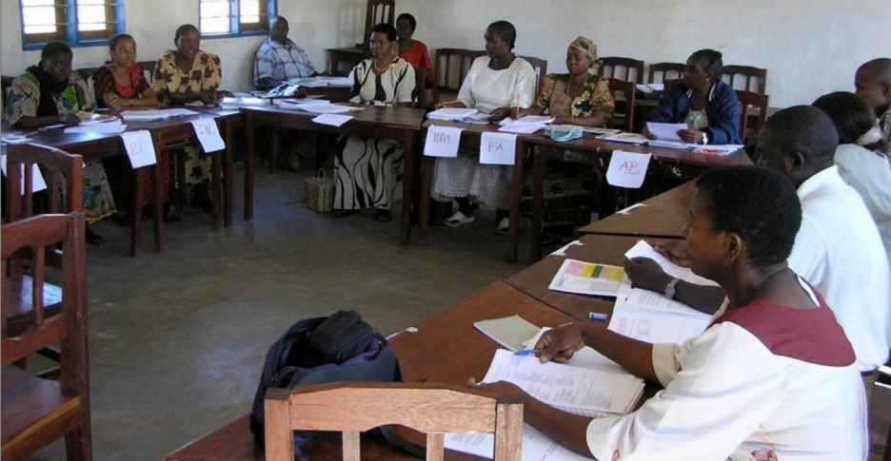
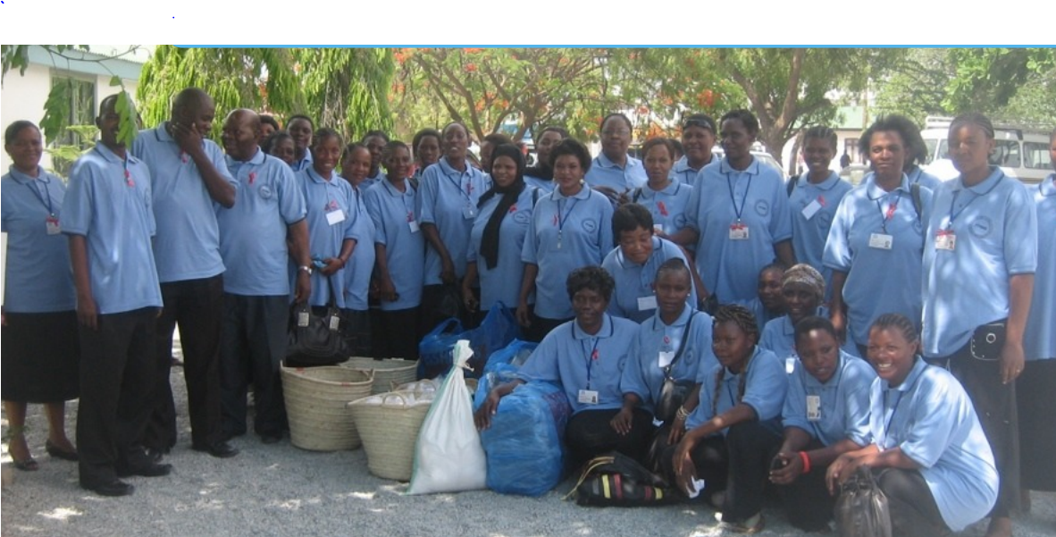
Community Health Workers
Nurses
Health system employees
Medical training, high school + education
Permanent, salaried positions
Full medical responsibilities
Community Health Worker
Members of community
Non-salaried
Incentive payments
Limited medical responsibilities

Slide 5
Worker tracking
Nigeria
Pakistan

Slide 6
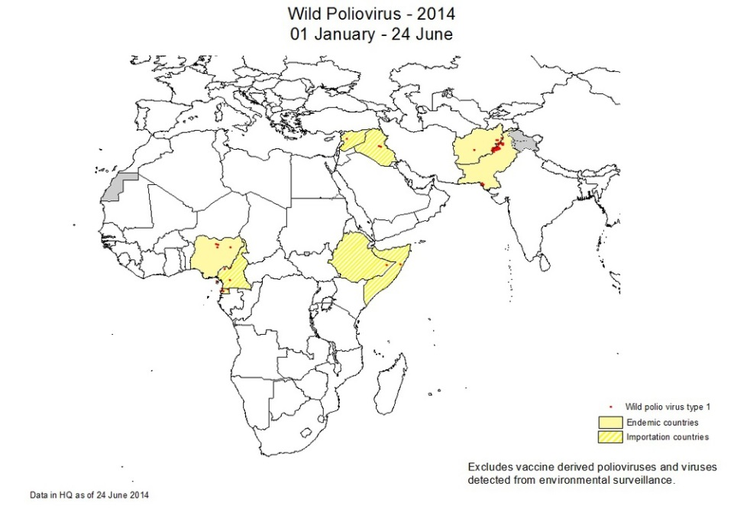
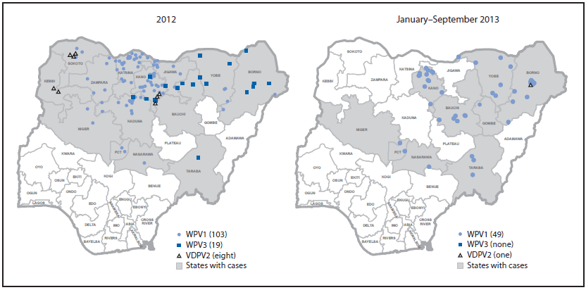
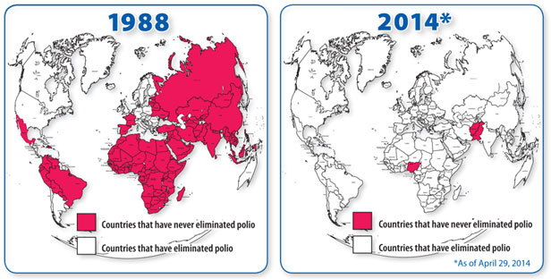
Polio
Polio cases
1988: 350,000
2013: 416

Slide 7
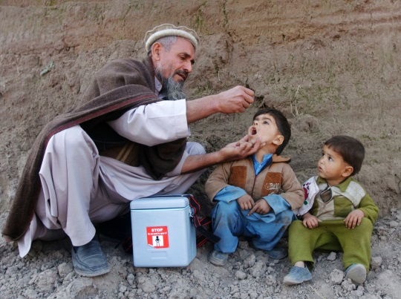
Polio Immunization Campaigns
IPV: 2, 4, 6, months, 6 years
OPV: 3 Months
Polio outreach campaigns
Vaccinators go door to door
Polio surveillance
Tracking cases of Acute Flaccid Paralysis (AFP)

Slide 8
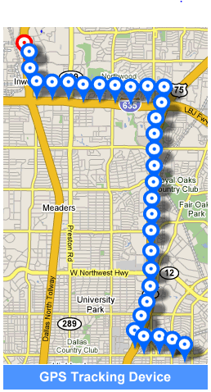
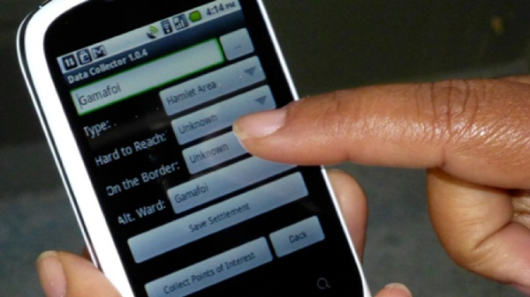
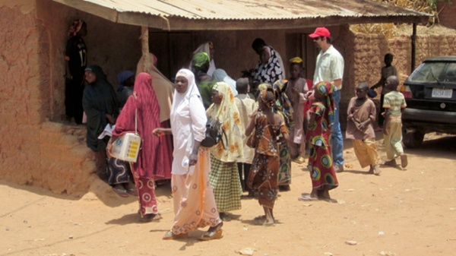
Tracking Immunization workers
GPS Device tracks workers
Separate GPS tracking device
Android phone with GPS application
Data capture application recording locations

Slide 9
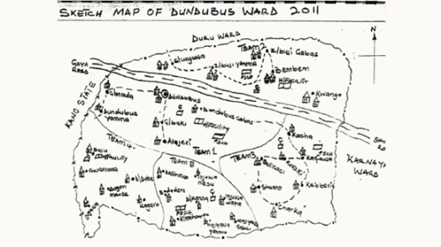
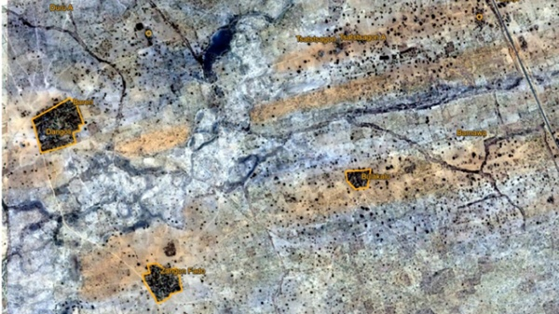
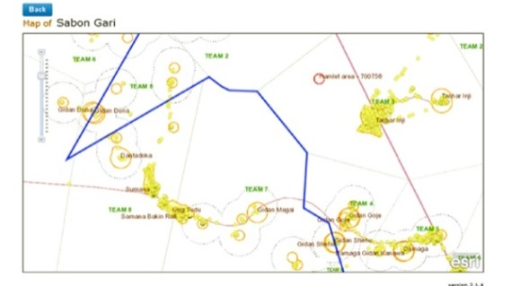
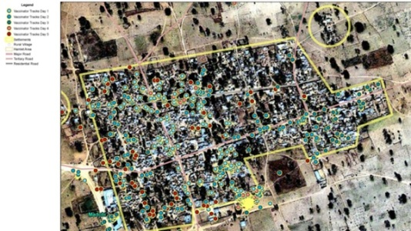
Nigeria
Develop micro plans based on satellite imagery
Record routes of workers
Compare with satellite imagery to estimate coverage

Slide 10
Health worker tracking
Logging use of application with timestamp
Recording GPS coordinates
Requiring photo of arrival
Monitoring and attendance applications

Slide 11
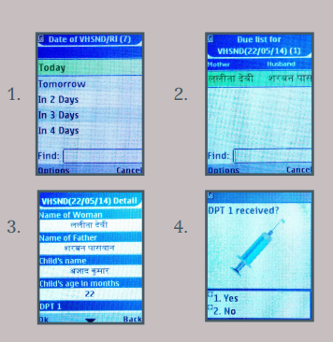
Health worker work lists
Immunization lists
List of kids with immunizations due
Follow up or missed immunizations
Immunization record keeping
Centralized record keeping
Child card for immunizations, due dates based on birthday
Tally sheet

Slide 12
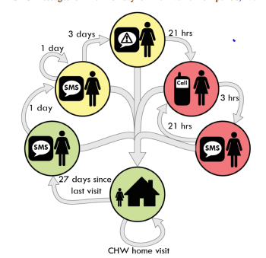
Health worker reminders
Reminders for CHW household visits
Multiple programs require regular visits
Reminder message with escalating messages
Reminder study, DeRenzi et al.
Commcare project
CHWs had phones
Response to reminders
Declined over time
Supervisor escalation helped
Just a threat!
Two way features important

Slide 13
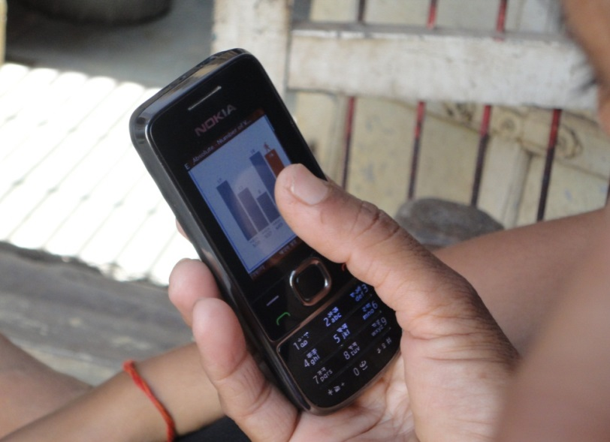
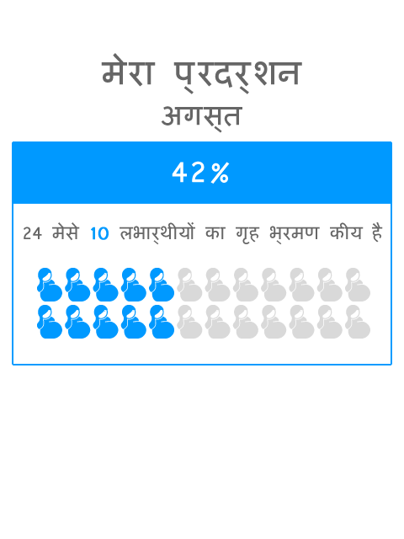
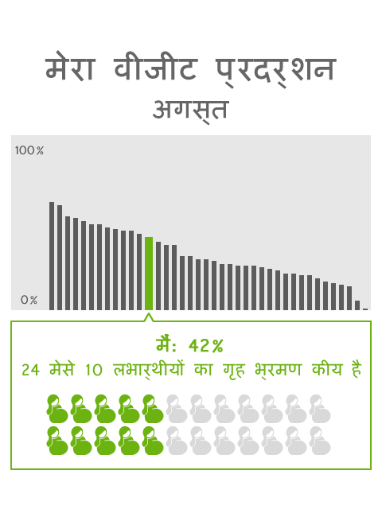
Health worker feedback systems
Messages sent to CHWs to incentivize good performance
Peer comparison
Individual feedback

Slide 14
Health worker support tools
Vision
Mobile phone based application with a suite of tools to enhance the ability of health workers to do their jobs

Slide 15
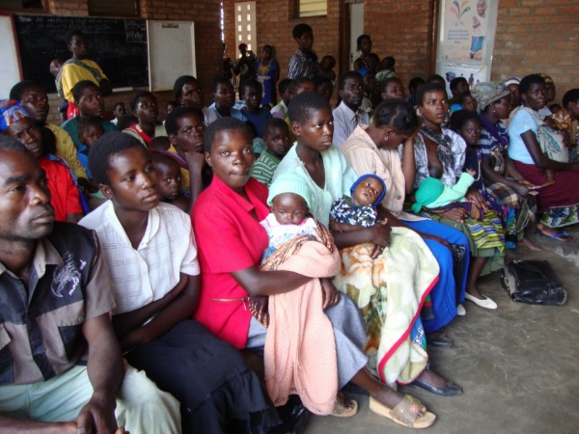
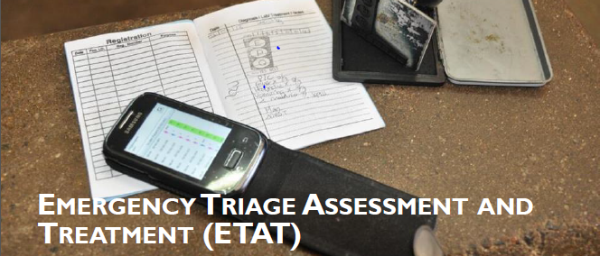
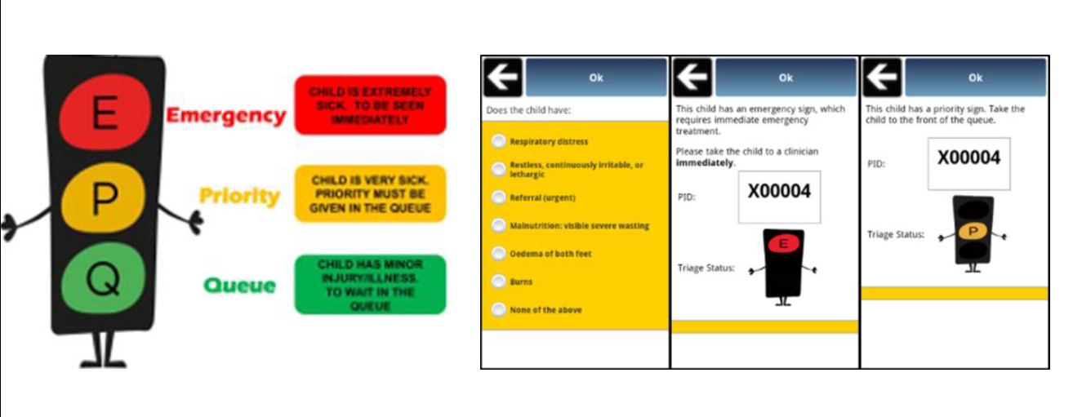
D-Tree
NGO Founded by Dr. Marc Mitchell
Focus on improving care through developing clinical protocols
Implement protocol on mobile device

Slide 16
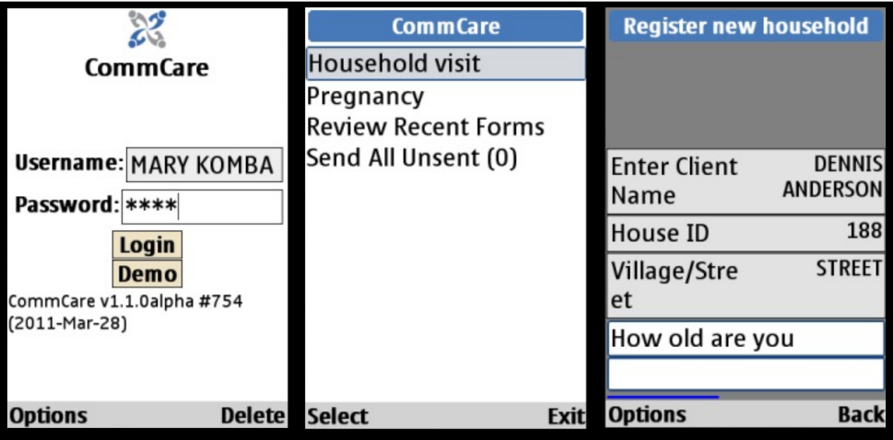
Commcare
Java application for mobile phones
Data collection
Client records
Back end: Commcare HQ

Slide 17
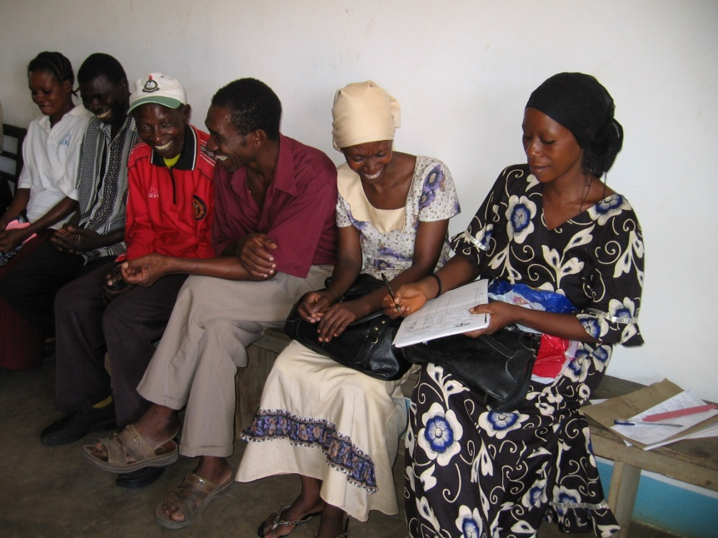
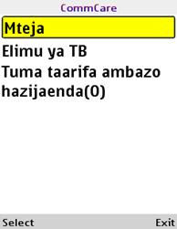
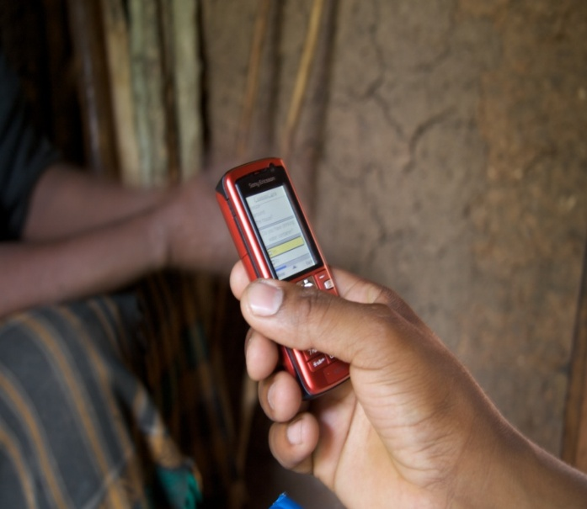
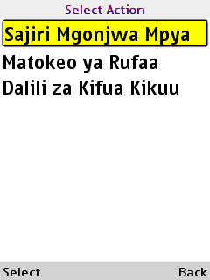
Commcare TB Referrals
Increase referrals for TB testing
Basic TB screening questions implemented on a mobile phone
Have you been coughing for more than two weeks?
Are you spitting up blood?

Slide 18
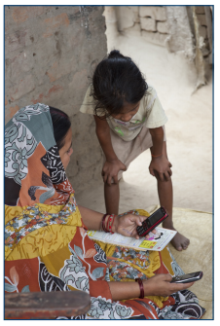
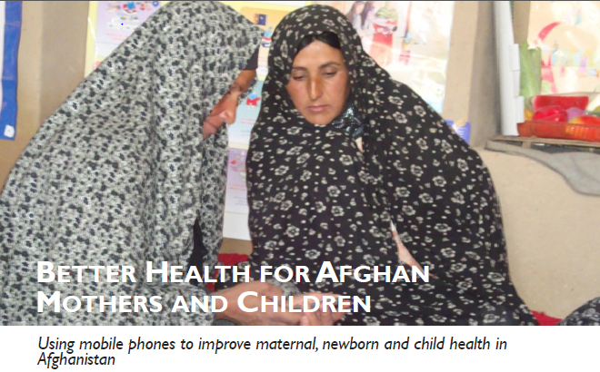
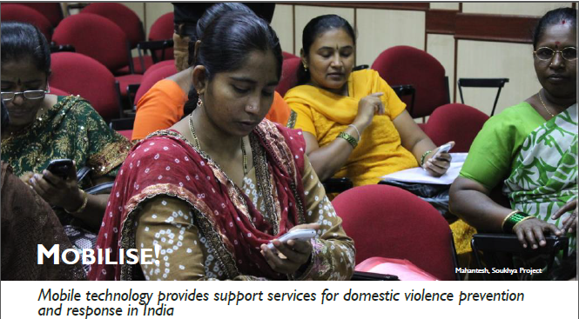
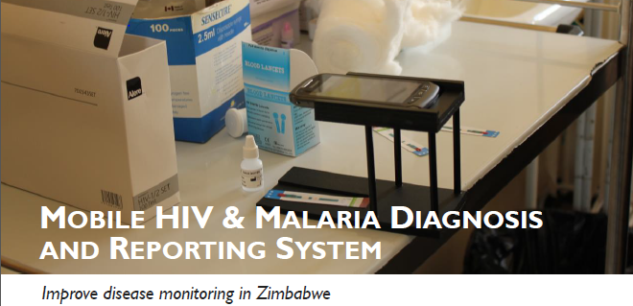
Commcare deployments

Slide 19
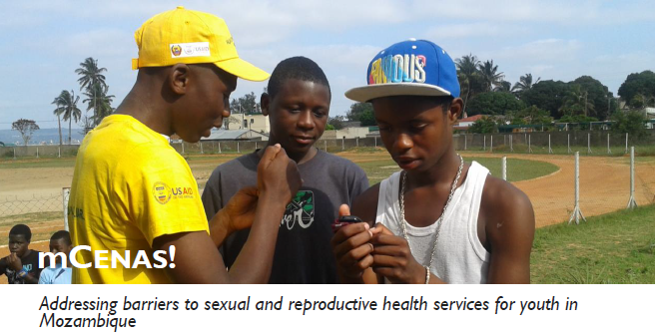
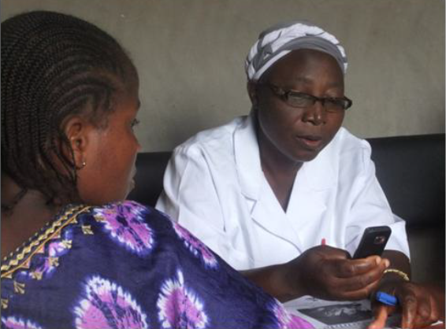
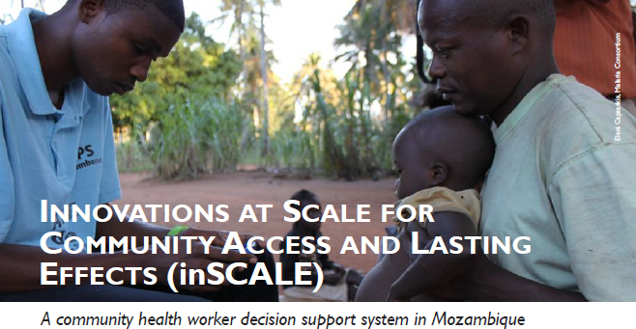
Commcare Deployments

Slide 20
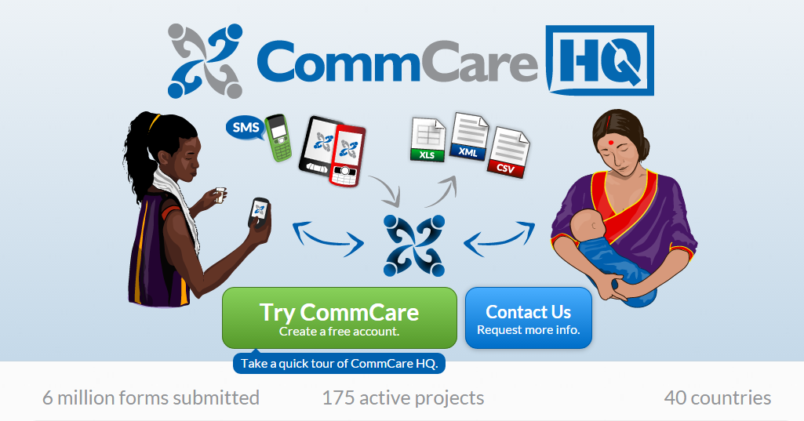
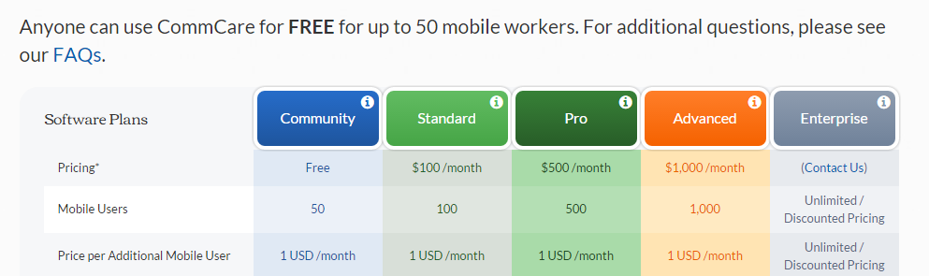
Dimagi

Slide 21
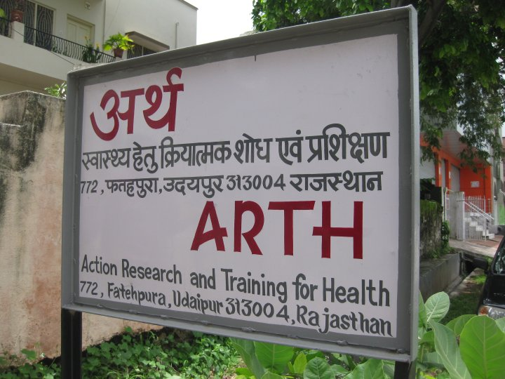
Mobile midwife project
UW, PATH, ARTH Collaboration

Slide 22
Project background
Participant goals
ARTH
Mobile tool to support midwife household visits
UW
Validate an Android based tool in the field
PATH
Evaluate the feasibility of a smart phone platform for front line health workers

Slide 23
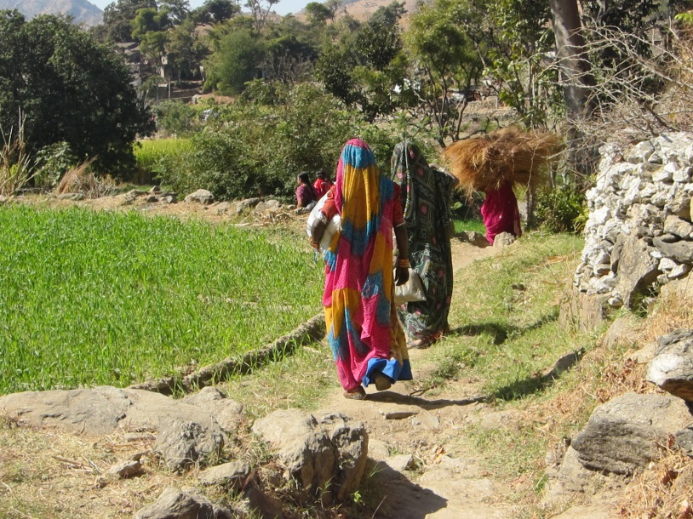
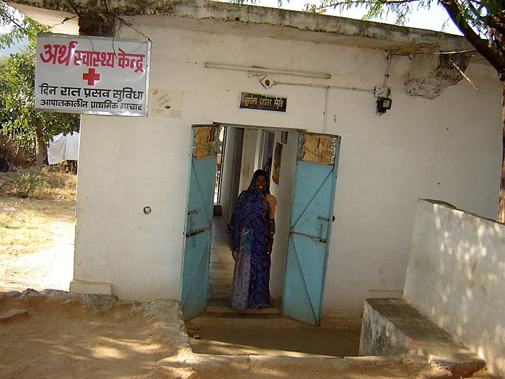
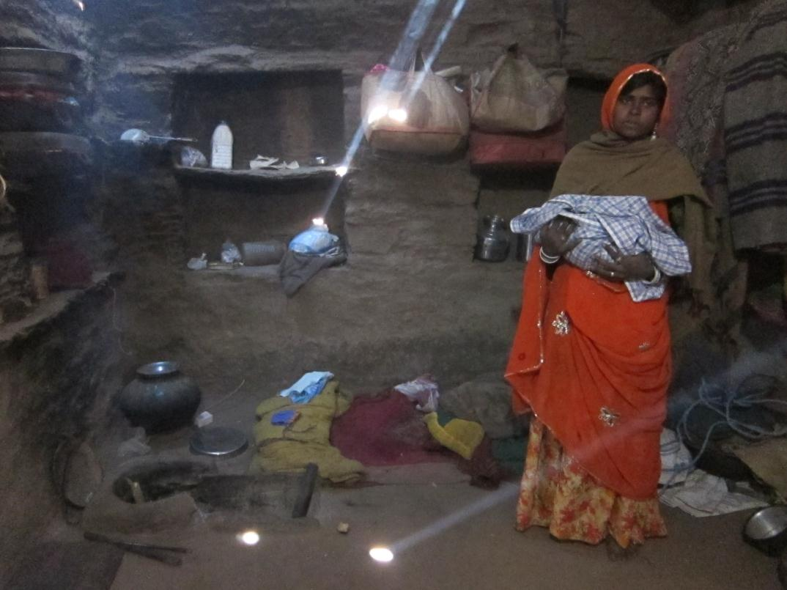
Formative Work
Site visits to facility and homes
Extensive office discussions for design

Slide 24
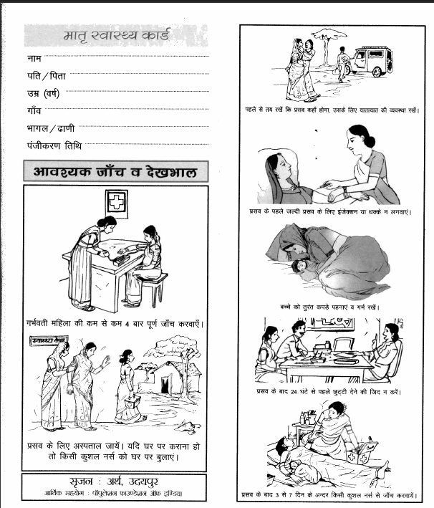
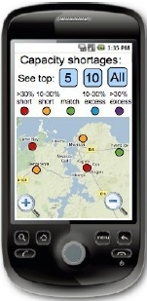
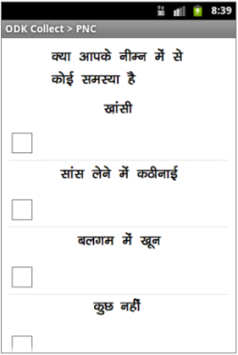
Application Design
Mobile data collection to support PNC visits
Data collection
Protocol support
Open Data Kit application
Android phones deployed with nurse midwives

Slide 25
Deployment
Action Research and Training for Health
Two maternal health clinics for a population of 64,000
Clinic and outreach services by two doctors and eight nurse midwives
Post Natal Care (PNC) visits using ARTH protocol
Two visits
In clinic or home

Slide 26
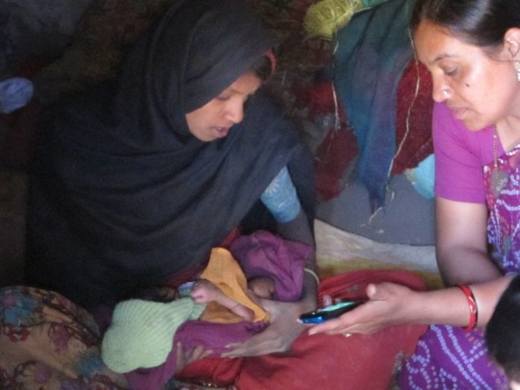
Results
Mixed results
Technical challenges around data entry and synchronization on multiple phones
Some of the nurses successfully used the devices
Obstacle to integrating data entry with existing infrastructure
Use of videos for education considered the most positive feature

Slide 27
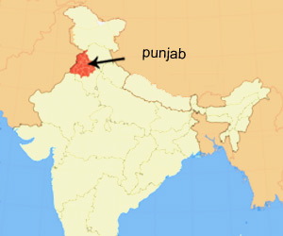
DHIS2 Mobile
Data reporting from mobile phone for DHIS2
Large scale deployment in Indian state of Punjab (starting about 2010)
Distribution of phones to 5,000 ANM (Auxiliary Nurse Midwife)
Nokia 2330, $40
Reporting application, but SMS not GPRS
Daily, Weekly, and Monthly reporting
Closed group calling an important feature

Slide 28
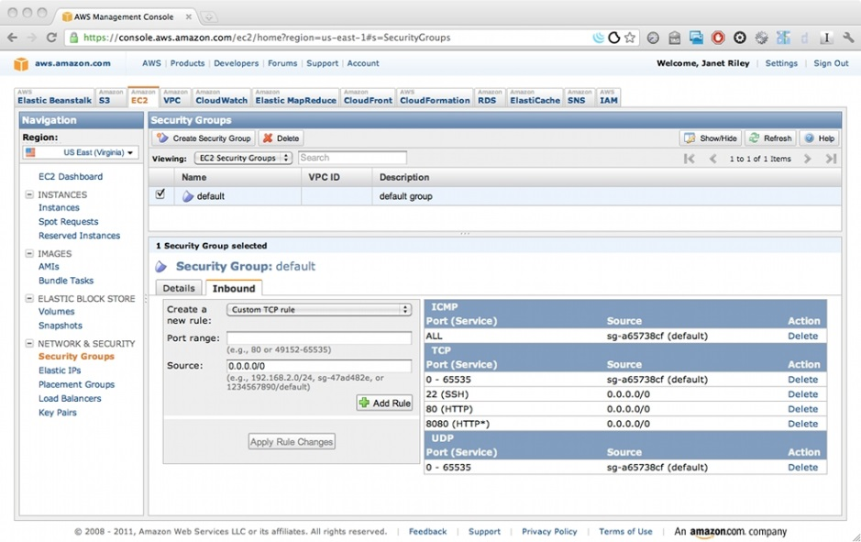
Global health and Security and Privacy

Slide 29
Disclaimers
User:
admin
Password:
district
I’m not a security expert
Slides put together for a brainstorming session
Computer security questions for global health might, or might not be interesting

Slide 30
Background – Burden of disease and health domains
Big three:
HIV, TB, Malaria
Maternal and Child Health
Immunization
Reproductive Health
Other infectious diseases
Neglected Tropical Diseases

Slide 31
Health Systems
Public health system
Hospital, Health Center, Health Post
Shortage of doctors
Private facilities, pharmacies may have a role
Some countries developing insurance schemes
Donors, NGOs, Global organizations play a major role

Slide 32
Infrastructure Electricity, Internet, Cell phone
Highly variable
Urban infrastructure often good
Rural can have limited power and connectivity
Computing
Mobile phones
Widely available
Basic, Feature, Smartphone
Different ownership models
Costs variable

Slide 33
Privacy
Health system less concerned/sensitive to privacy issues
Expectations of privacy different
Clinical studies often very strict on privacy
IRB Issues
Country oversight
Country health data frameworks not as strict as HIPAA

Slide 34
Stigma
Stigma around disease / condition is a great concern
Levels of stigma vary, and often not understood
HIV, Tuberculosis, Malaria, Diabetes, Pregnancy, Family Planning, STDs, Mental Illness, Drug Use, Alcohol Use, Abortion, Immunization Status, Maternal health practices

Slide 35
ICT Applications
Surveillance data reporting: DHIS2
Medical record systems: OpenMRS
Logistics management: OpenLMIS
Data reporting: Open Data Kit
Health worker support: CommCare

Slide 36
Processes
Managing a register
National TB register
Immunizations
Reporting diagnostics
Laboratory testing, reporting results
Visit reminders
Informational messages
Counselling messages

Slide 37
Other issues
Tracking identity
Medication adherence
Identification of counterfeit drugs
Tracking health workers
Verification of attendance
Household visits
Protecting privacy, geolocation

Slide 38
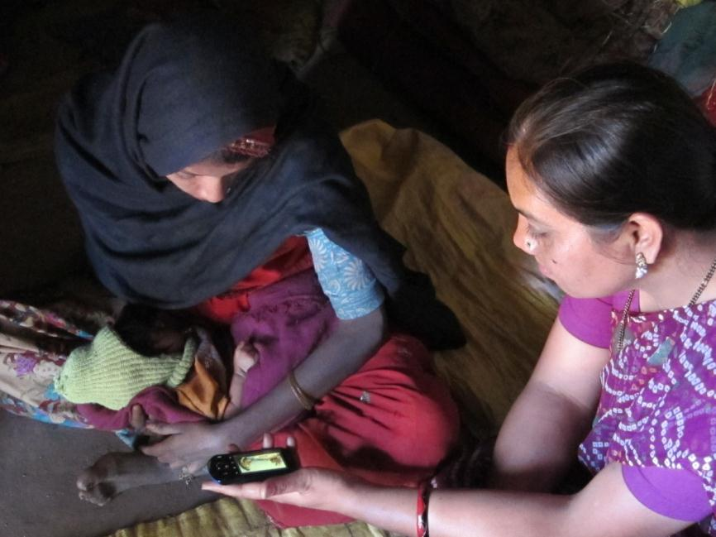
Next week
Ed Jezierski
Behavior change communication

